Slide 1
Mental Health in Tech

Slide 2
Data Background and Goals
2014 Survey by Open-Sourcing Mental Illness
Attitudes, experiences, and histories of people working in tech
Can we determine if people will be comfortable talking about mental health?
What contributes to willingness to talk about mental health?
Can we improve workspace environments in relation to mental health?

Slide 3
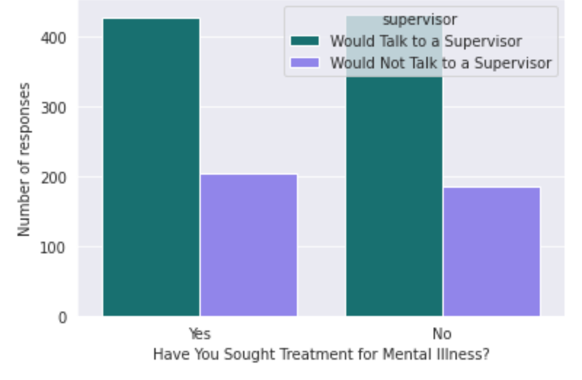
A Person’s comfort level isn’t correlated with their personal history of mental illness

Slide 4
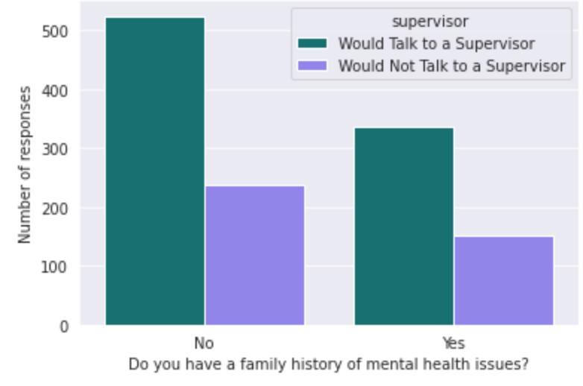
A Person’s comfort level is correlated with their family history of mental illness
Slightly less likely to want to talk about mental illness if they have a family history

Slide 5
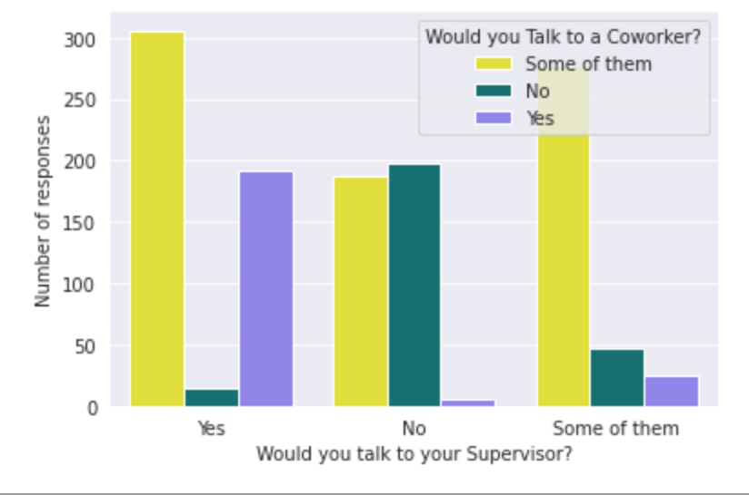
Those who would not talk to a supervisor might talk to a coworker

Slide 6
Machine learning model:
Can predict with 80% accuracy if someone is comfortable talking about their mental health with a supervisor.

Slide 7
Final Observations and Recommendations:
Half of respondents have sought treatment for mental health, but a high percentage of respondents are not comfortable with the topic.
Supervisors or employers begin conversations about mental health
Coworker support for mental health issues (consult an expert)

